Slide 1
Bayesian classification problem

Slide 2
A Bayesian classifier is a probabilistic model based on Bayes' theorem used for classification tasks.
The most common example is Naïve Bayes, which assumes that features are conditionally independent given the class.

Slide 3
Bayesian Classifier Problem Example
Problem Statement:
A bank wants to classify whether a loan applicant is high risk or low risk based on certain features:
Income Level (High, Medium, Low)
Loan Amount Requested (High, Medium, Low)
Credit Score (Good, Average, Poor)
Given historical data, the bank wants to determine the probability that a new applicant is high risk or low risk based on the provided features.

Slide 4
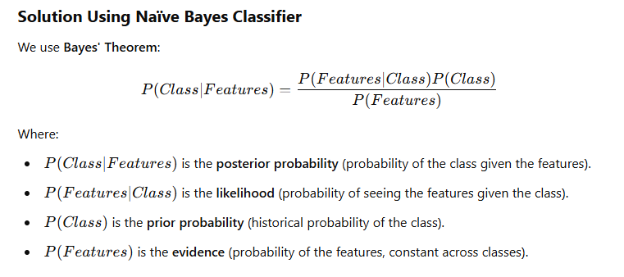

Slide 5
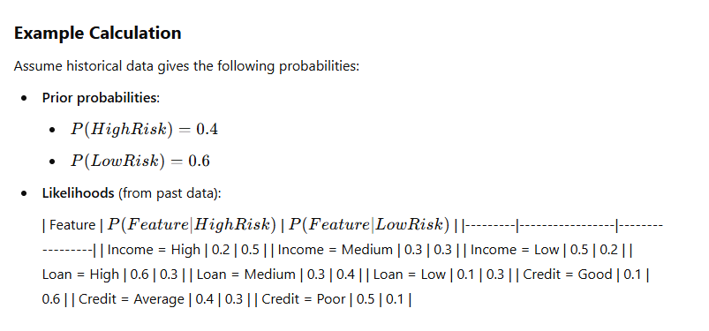

Slide 6
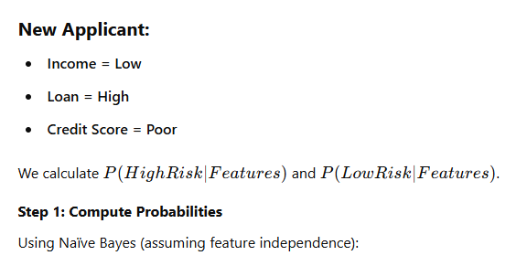
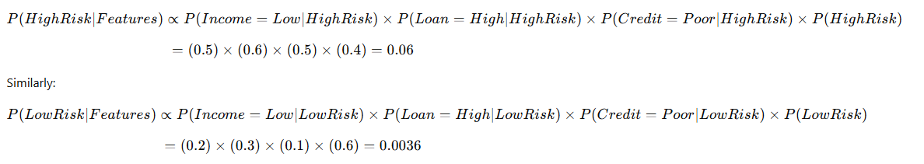

Slide 7
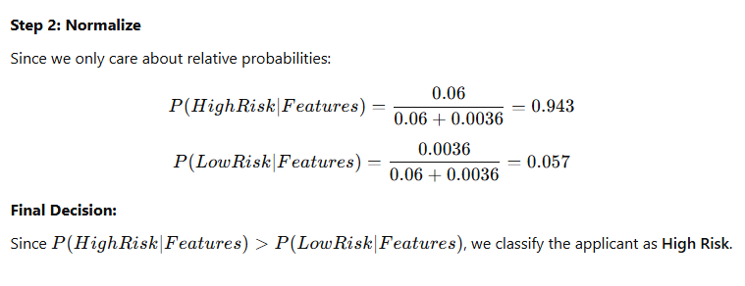

Slide 8
Applications in Civil Engineering
Bayesian classification is widely used in civil engineering for risk assessment, structural health monitoring, geotechnical engineering, and decision-making under uncertainty. Here are some key applications:

Slide 9
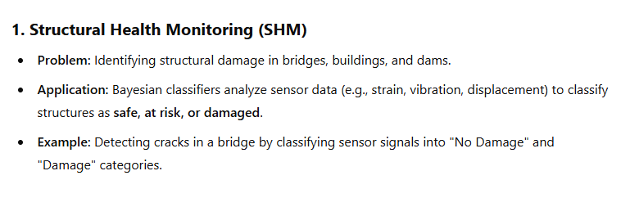
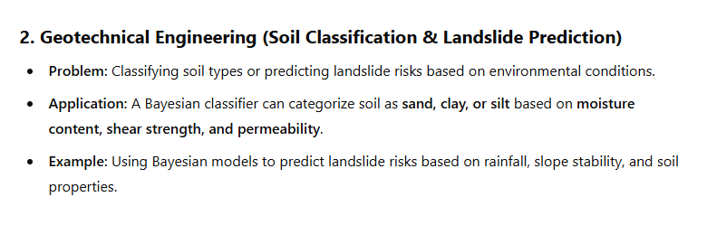

Slide 10
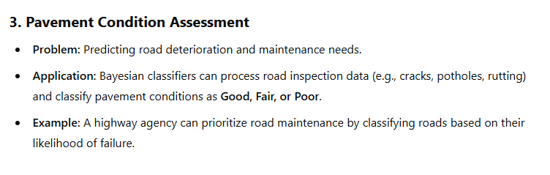
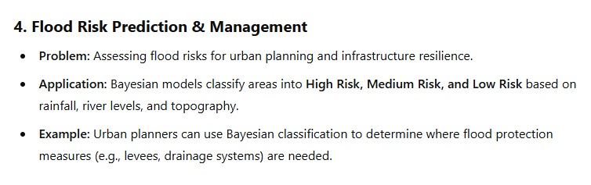

Slide 11
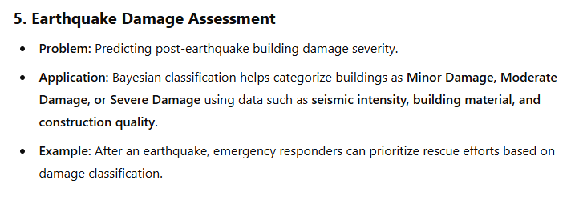
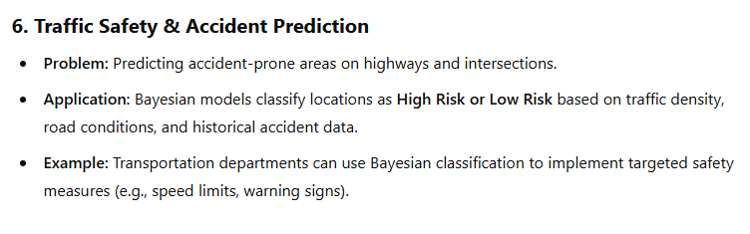

Slide 12
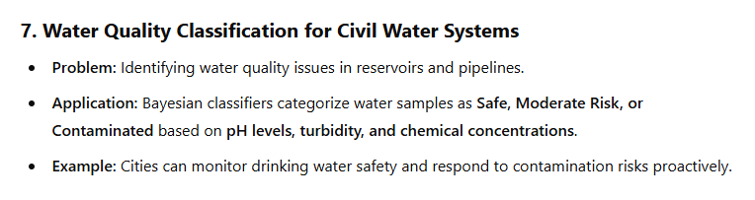
Conclusion
Bayesian classification helps civil engineers make data-driven decisions under uncertainty, improving safety, efficiency, and reliability in various applications.

